Slide 1
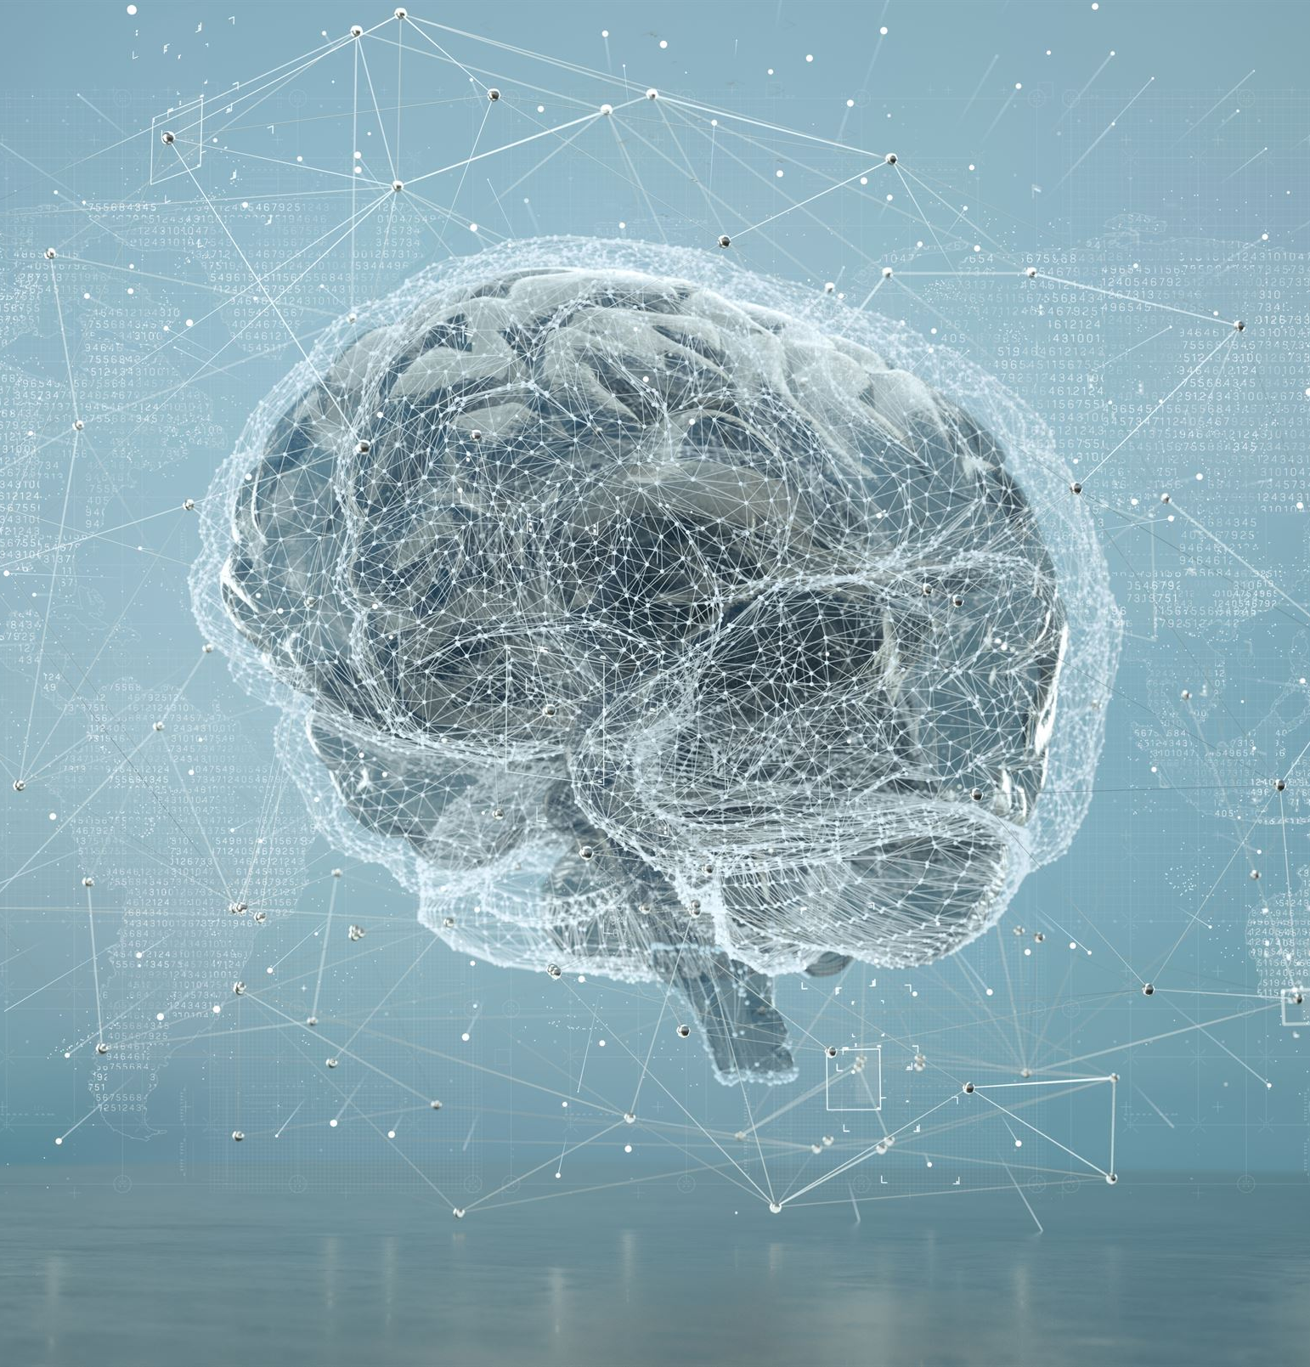
Building Brain-Computer Interface Applications with .NET MAUI: A Beginner-Friendly Guide
Explore BCI concepts and application development techniques.
Notes:
"Hello everyone, welcome to this session on building Brain-Computer Interface applications using .NET MAUI. Today, I’ll walk you through how we can simulate brain signal data, visualize it, and build a cross-platform mobile and desktop app—all without real BCI hardware."

Slide 2
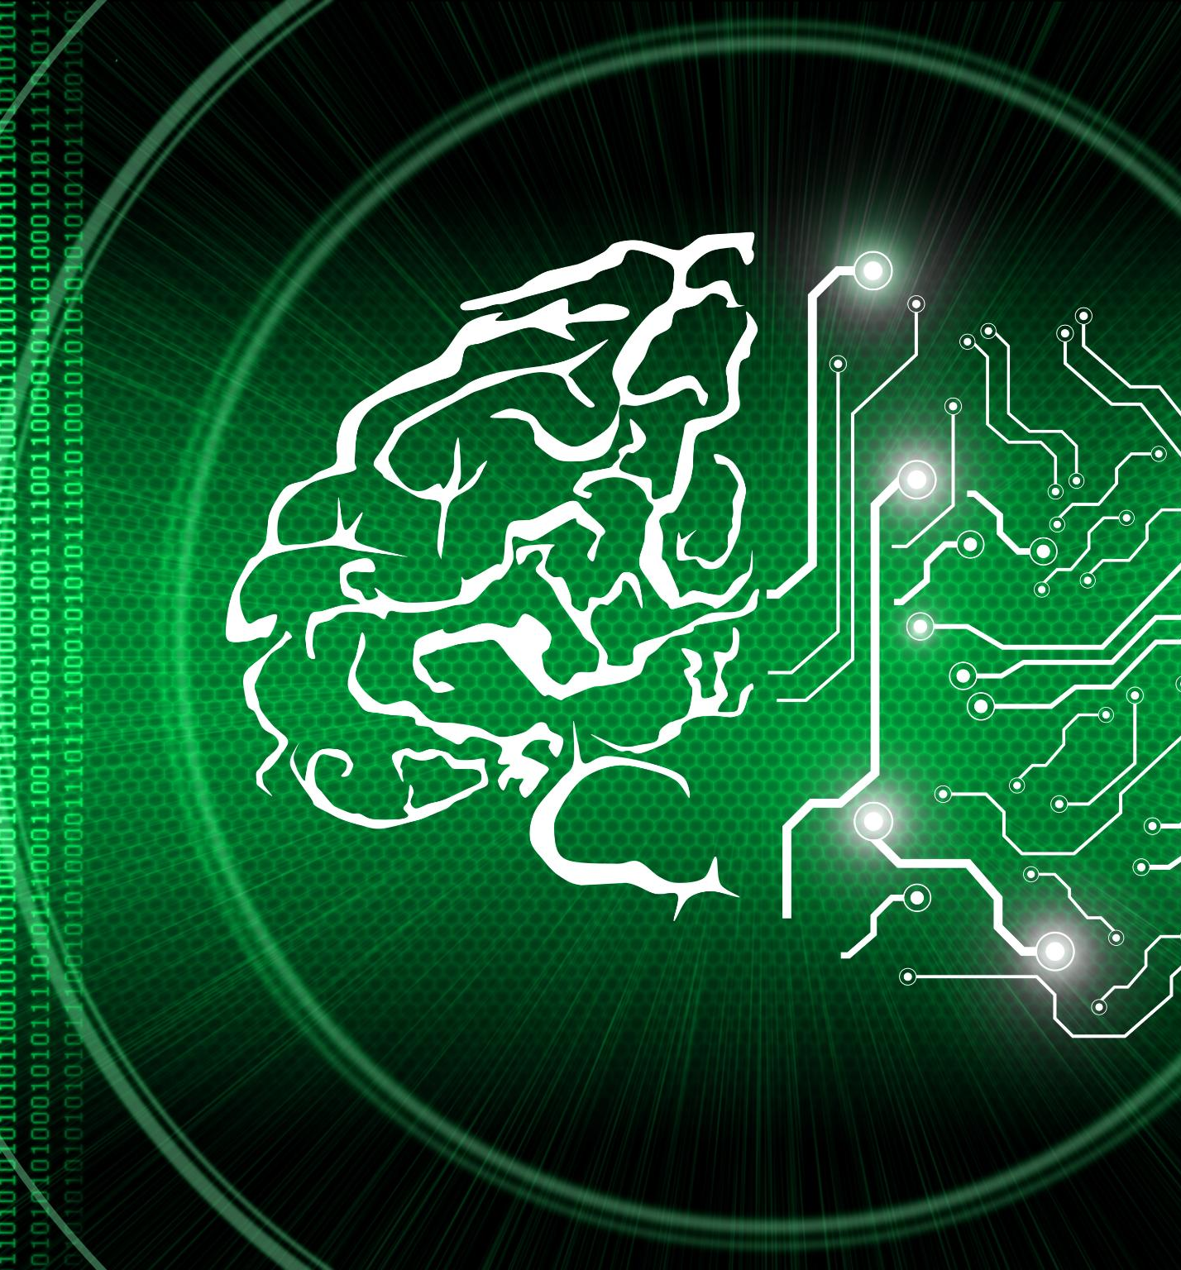
Agenda of the Presentation
Introduction
Technical Overview
Getting Started
Core Implementation
Code Examples
Best Practices
Demo Application
Resources and Next Steps
Notes:
In this presentation, we will start with an introduction to BCIs and .NET MAUI, followed by a technical overview including architecture and components. We will provide guidance on setting up your development environment and implementing core features before showcasing code examples and best practices. Finally, we will present a demo application and discuss additional resources.

Slide 3


Introduction
Notes:
Understanding the foundational concepts of Brain-Computer Interfaces and .NET MAUI is crucial for building effective applications. We'll explore what BCIs are, how .NET MAUI works, and the advantages of using it for BCI applications.

Slide 4

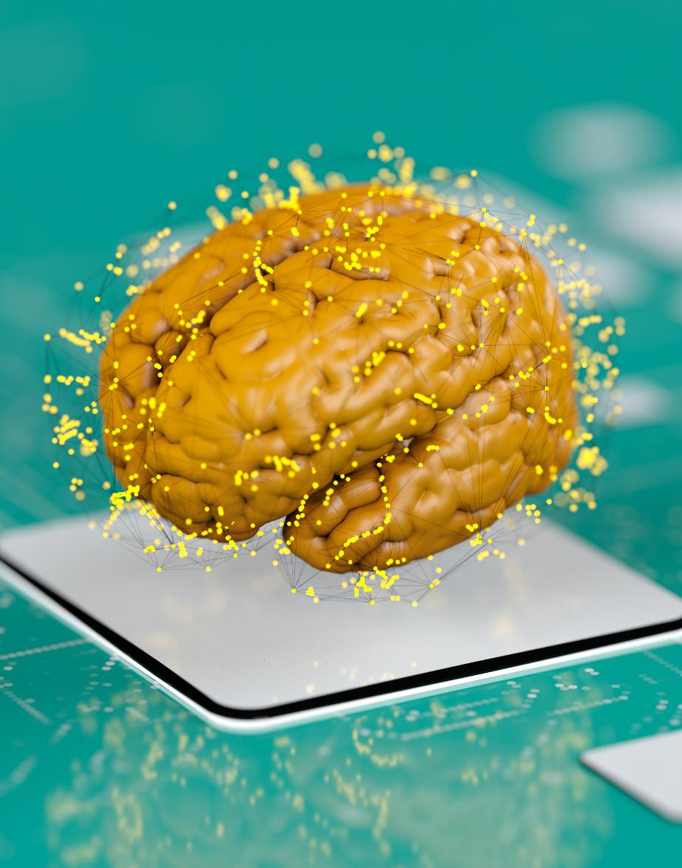
What Is BCI (Brain-Computer Interface)?
Direct Brain Communication
BCI technology enables direct communication between the brain and external devices, creating a seamless interaction.
Applications in Medicine
BCI technology has significant applications in medicine, particularly in aiding individuals with mobility impairments.
Gaming and Entertainment
In gaming, BCI technology allows for an immersive experience, enabling players to control games through thought alone.
Accessibility Improvements
BCI technology enhances accessibility, allowing individuals with disabilities to interact with technology more easily.
Notes:
"Brain-Computer Interfaces allow direct communication between a brain and an external device. Real BCIs involve complex signal processing, but for developers and learners, simulated data can still offer valuable insights into UX, UI, and system integration."

Slide 5
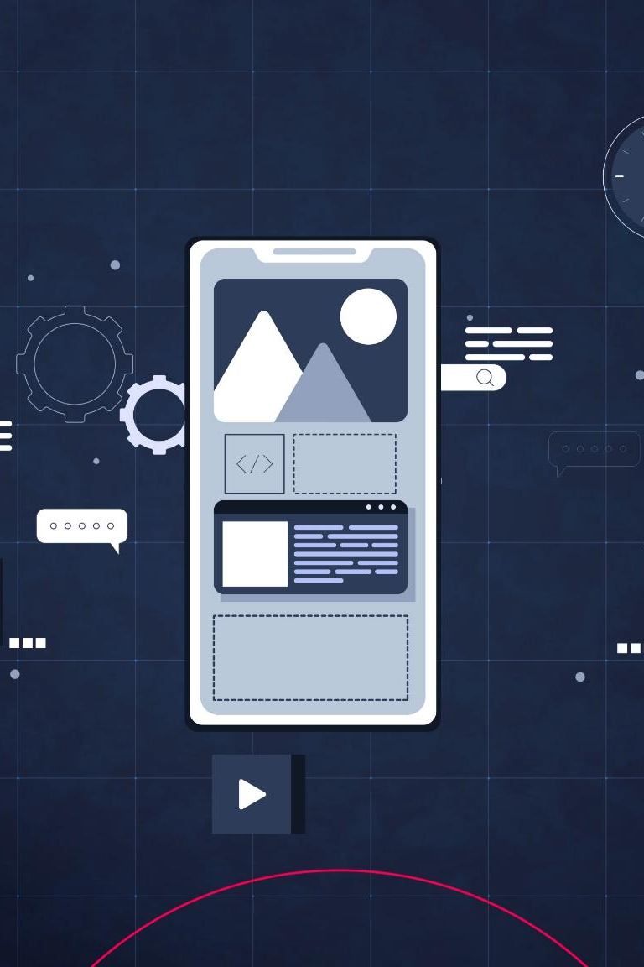
What Is .NET MAUI?
Cross-Platform Framework
.NET MAUI allows developers to build native applications across multiple platforms using a single codebase, making coding more efficient.
Native Applications
.NET MAUI enables the creation of native applications for iOS, Android, macOS, and Windows, ensuring optimal performance on each platform.
Simplified Development
.NET MAUI simplifies the development process for apps, enhancing productivity by reducing the amount of code needed.
Notes:
.NET MAUI (Multi-platform App UI) is a cross-platform framework for building native applications for iOS, Android, macOS, and Windows with a single codebase. It simplifies the development process and enhances productivity for developers.

Slide 6

Why Use .NET MAUI for BCI Applications?
Cross-Platform Development
With .NET MAUI, developers can efficiently create applications that run on multiple platforms, ensuring wider accessibility.
Responsive User Interfaces
MAUI allows developers to design responsive user interfaces that adapt to different screen sizes and resolutions seamlessly.
Consistent User Experience
Using .NET MAUI ensures a consistent user experience across various operating systems, enhancing usability and satisfaction.
Notes:
Using .NET MAUI for BCI applications allows developers to create responsive and interactive user interfaces across multiple platforms efficiently. MAUI's capabilities ensure a consistent experience regardless of the operating system.

Slide 7
Real-World Applications and Use Cases
Rehabilitation for Disabilities
BCI technology is being utilized in rehabilitation programs to assist individuals with disabilities in regaining motor functions.
Gaming Enhancements
BCI technology enhances gaming experiences by allowing players to control games using their brain signals, creating a more immersive experience.
Inspiration for New Projects
Exploring BCI applications can inspire innovative ideas for projects in various fields such as healthcare and entertainment.
Notes:
BCI technology has a wide range of applications, from rehabilitation for individuals with disabilities to enhancing gaming experiences. Understanding these use cases can inspire new ideas for your own projects.

Slide 8

Technical Overview
Notes:
In this section, we will delve into the technical aspects of BCI applications, discussing the architecture, essential components, and how .NET MAUI's cross-platform capabilities can be utilized effectively.

Slide 9

Basic Architecture of a BCI Application
Data Acquisition Layer
This layer is responsible for capturing brain signals through sensors, forming the basis for further processing.
Signal Processing Layer
In this layer, captured signals are filtered and analyzed to extract meaningful information for interpretation.
User Interface Layer
The user interface presents processed information to the user, facilitating interaction and control over applications.
Notes:
A typical BCI application consists of multiple layers including data acquisition, signal processing, and user interface. Understanding this architecture is essential for successful implementation.

Slide 10

Key Components (Data Acquisition, Processing, Visualization)
Data Acquisition
Data acquisition involves capturing brain signals using various sensors, crucial for effective BCI applications.
Signal Processing
Processing involves analyzing and interpreting captured signals to derive meaningful insights for user interaction.
Data Visualization
Visualization is the final step, displaying the results in an understandable format for the user to interact with.
Notes:
The three key components of a BCI application are data acquisition, where brain signals are captured; processing, where signals are analyzed and interpreted; and visualization, where results are displayed to the user.

Slide 11
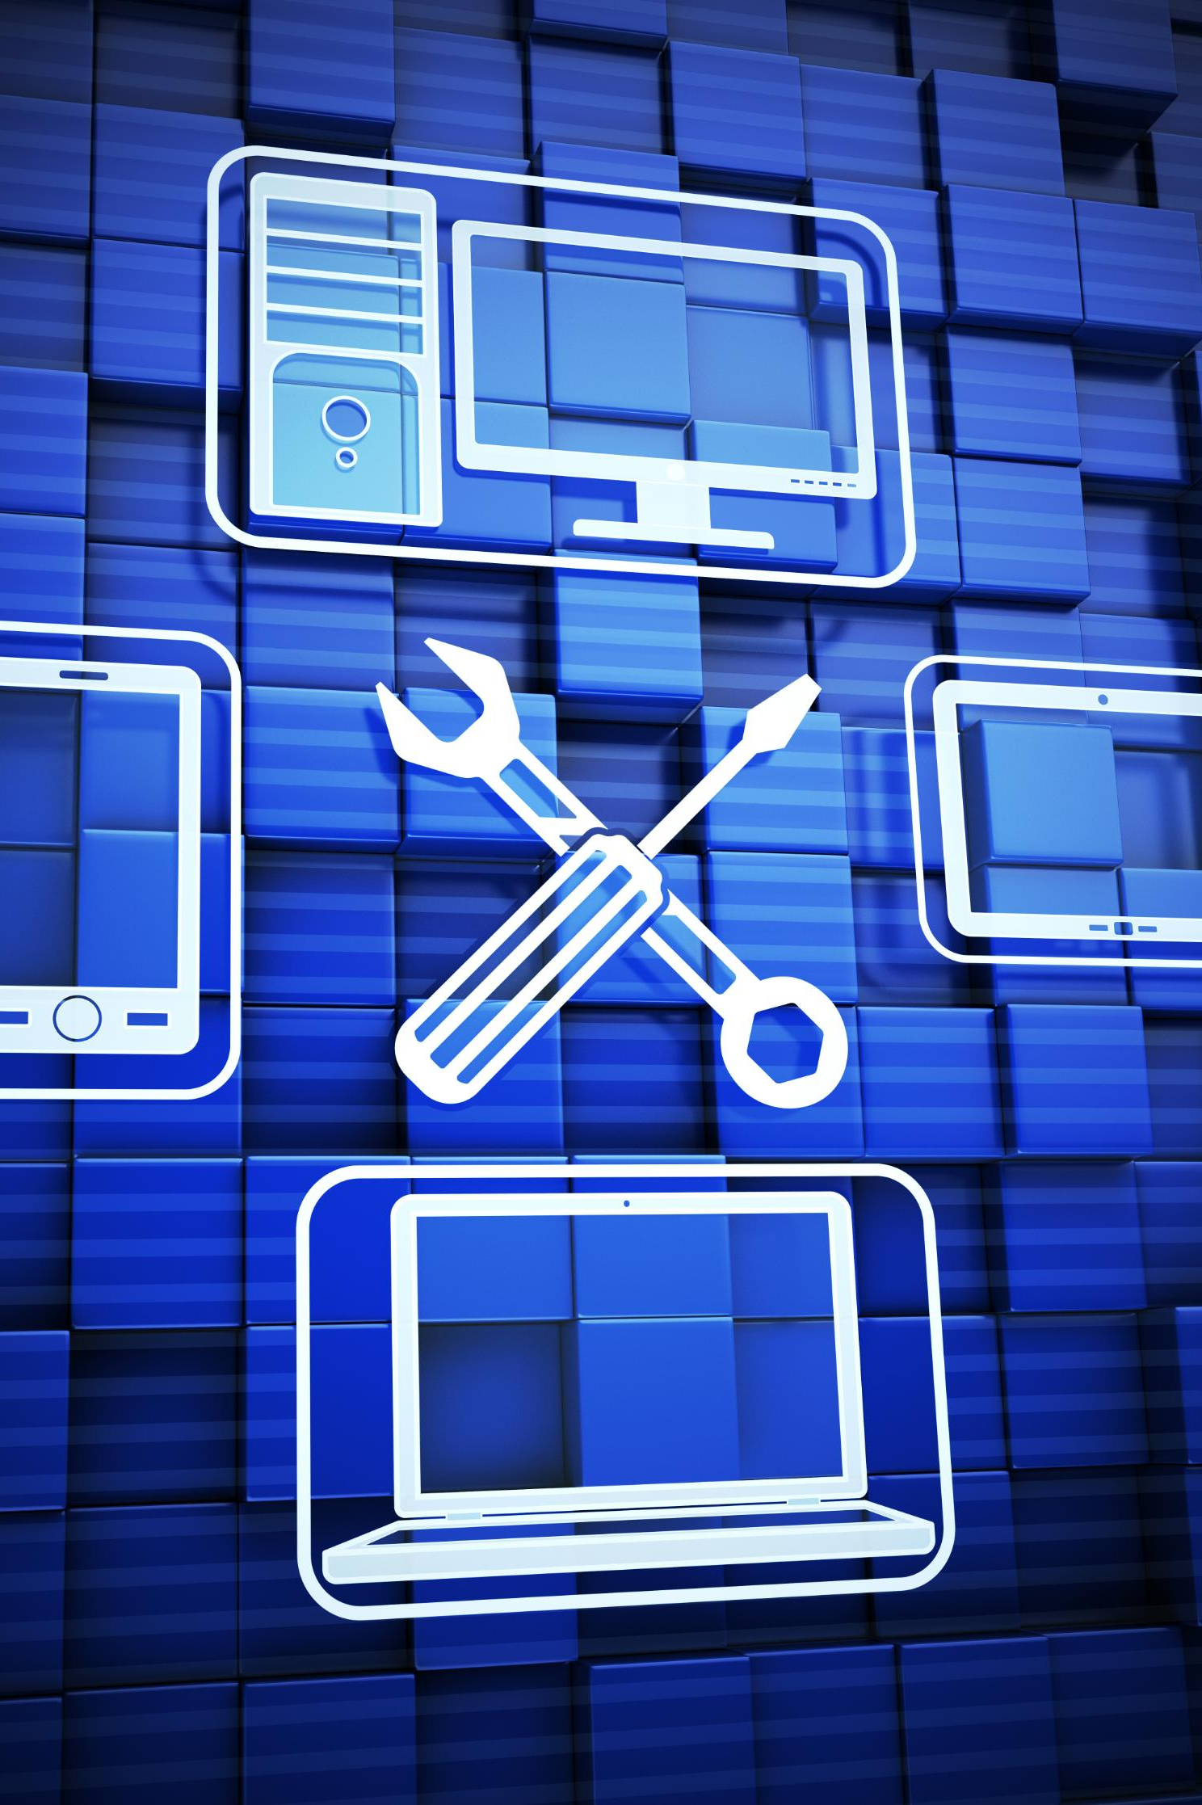
MAUI's Cross-Platform Capabilities for BCI Apps
Single Codebase Development
MAUI enables developers to create a single codebase for applications, simplifying the development process for BCI apps.
Consistent Functionality
With MAUI, BCI applications maintain consistent functionality across various platforms, ensuring a seamless user experience.
Deployment Efficiency
MAUI's capabilities allow for faster deployment across multiple devices, saving time and resources in the development cycle.
Notes:
MAUI allows developers to write code once and deploy it on multiple platforms, which is ideal for BCI applications that require consistent functionality across devices. This section will explore how to leverage these capabilities.

Slide 12

Getting Started
Notes:
Now that we have a sound understanding of BCI and .NET MAUI, we will guide you through the initial steps to get your development environment ready for building BCI applications.

Slide 13

Required Development Environment Setup
Setting Up .NET MAUI
To get started with .NET MAUI, you need to install the appropriate tools and workloads for development.
Installing Visual Studio
Visual Studio is essential for .NET MAUI development, providing a robust environment to create applications.
Notes:
To get started, you need to set up your development environment with .NET MAUI and the necessary tools. This includes installing Visual Studio and the MAUI workload.

Slide 14
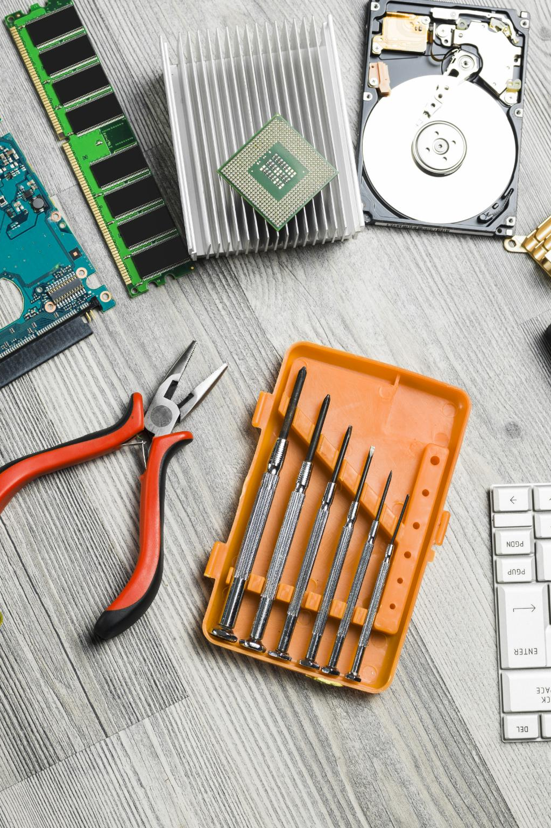
Essential Tools and SDKs
Device Connectivity Tools
These tools facilitate communication between brain-computer interface devices and other systems, enabling seamless data transfer.
Data Processing SDKs
SDKs for processing data from BCIs are crucial for interpreting signals and providing meaningful insights.
Development Frameworks
Frameworks provide the foundational structure for building applications, aiding in BCI software development.
Notes:
In addition to .NET MAUI, other tools and SDKs are necessary for BCI development, especially for device connectivity and data processing.

Slide 15
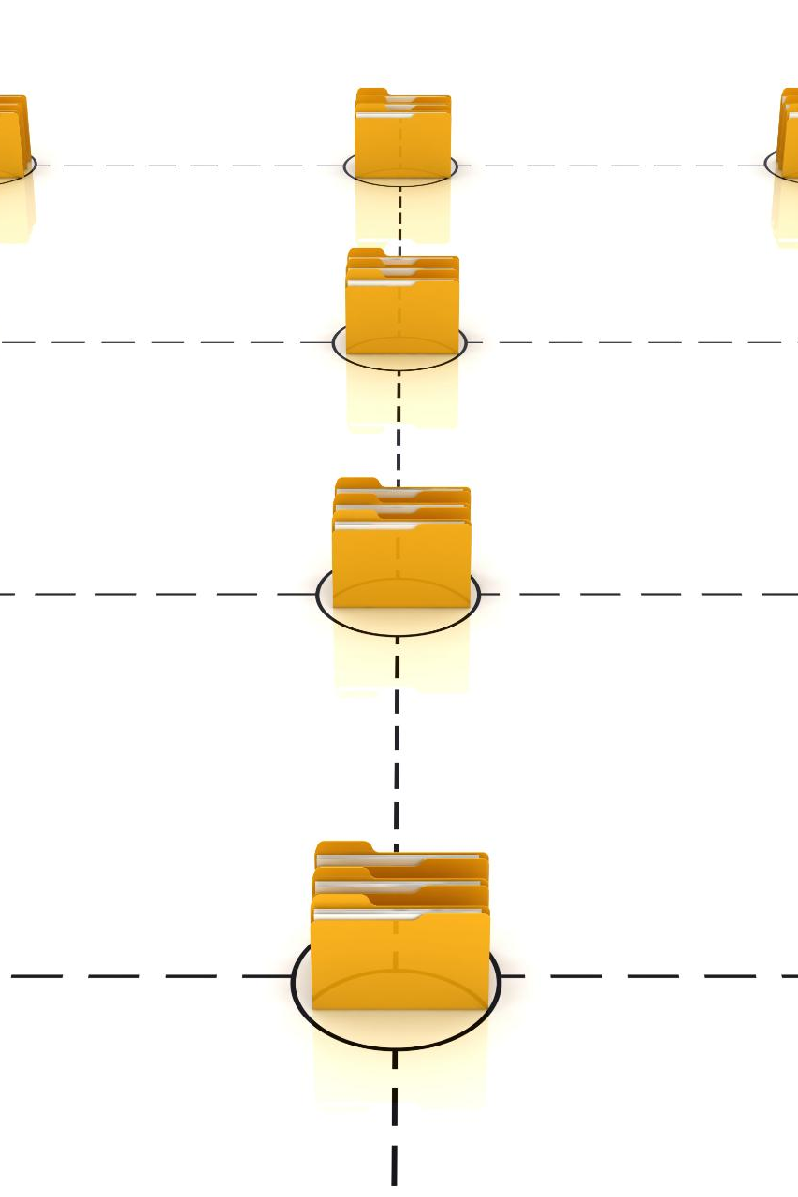
Basic MAUI Project Structure for BCI Apps
Understanding .NET MAUI
.NET MAUI (Multi-platform App UI) allows developers to create cross-platform applications, making it essential to know the project structure.
Project Folders and Files
Familiarity with the folders and files within a .NET MAUI project aids in organizing the code effectively for BCI applications.
Implementing BCI Logic
Knowing where to implement BCI-specific logic in your project structure is crucial for efficient development.
Notes:
Understanding the basic structure of a .NET MAUI project will help you navigate your application effectively. We will discuss the folders, files, and where to implement your BCI-specific logic.

Slide 16
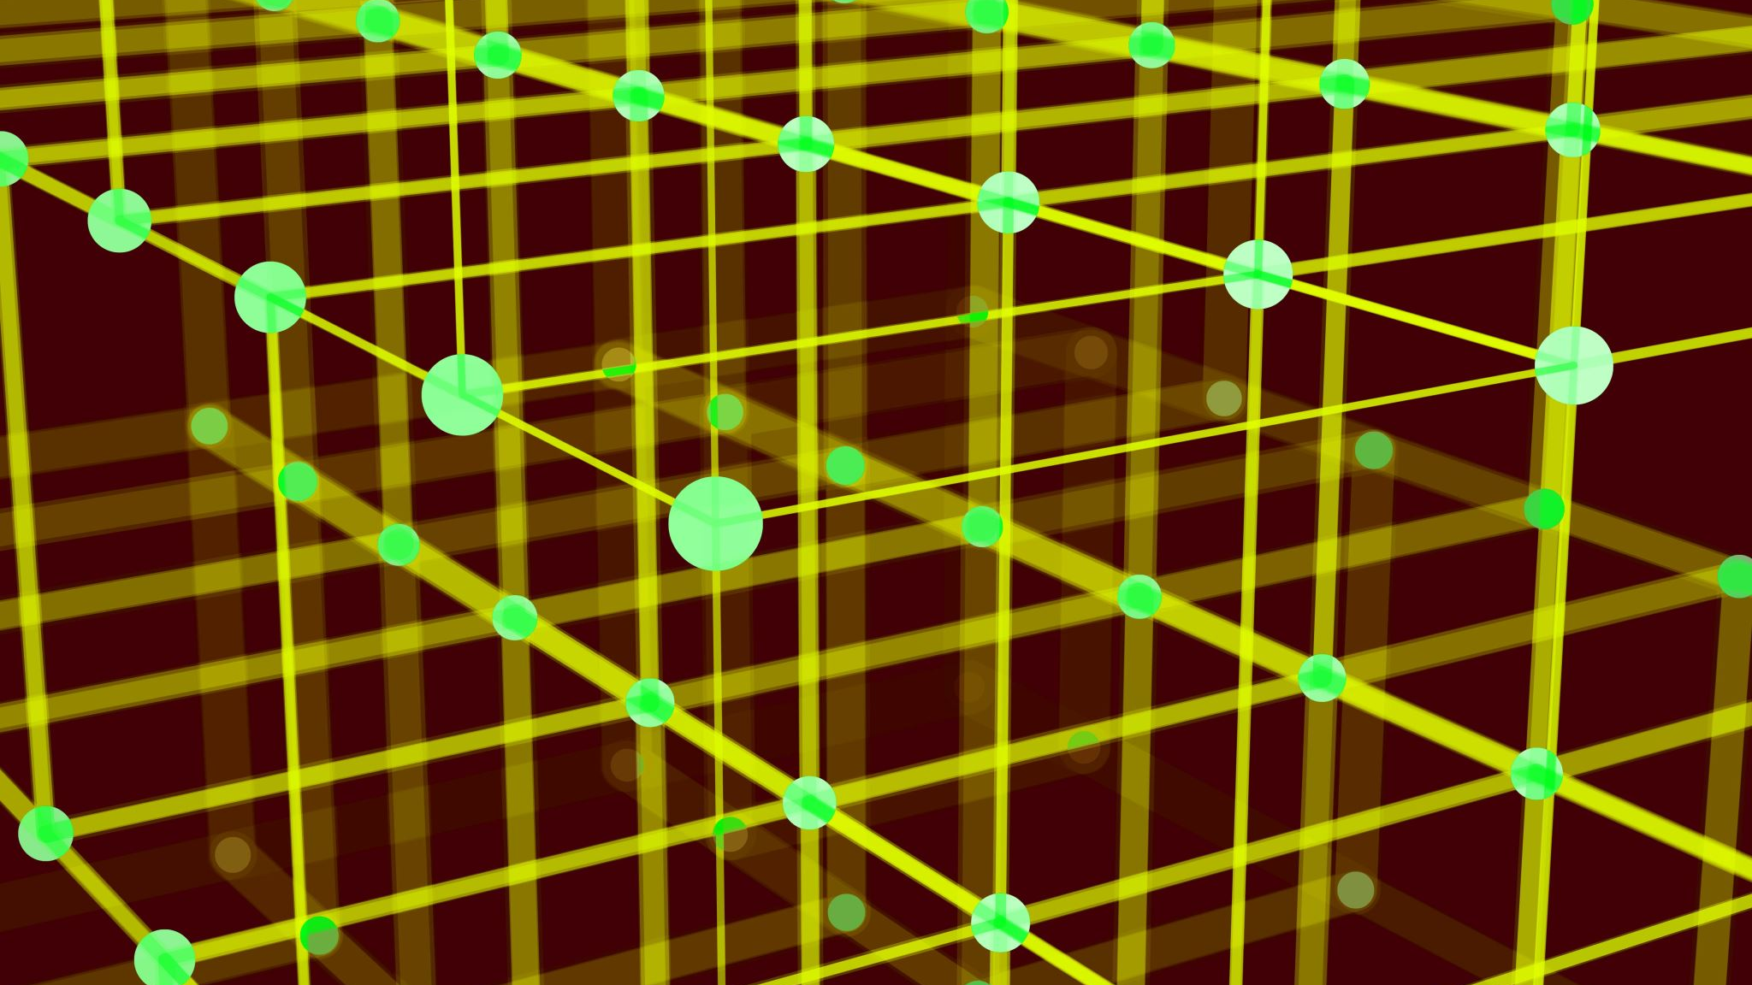
Core Implementation
Notes:
"This is where the BCIMockApp comes in. It simulates a BCI environment—connecting to a mock device, generating synthetic brainwave signals like delta, theta, alpha, and beta, and visualizing concentration levels and mental states."

Slide 17
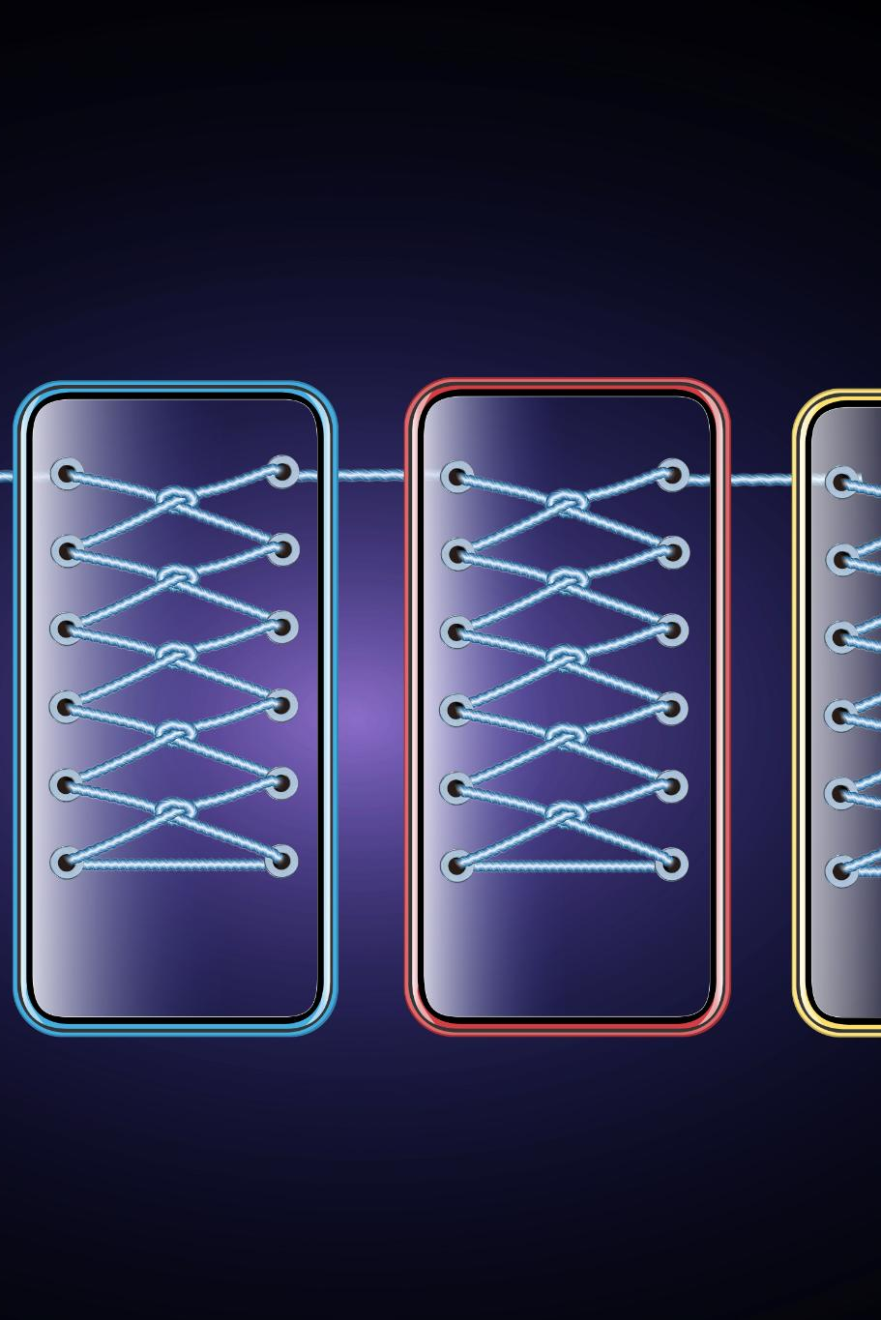
How to Connect to BCI Devices (Using EMOTIV/OpenBCI as Example)
Understanding BCI Devices
BCI devices provide a means to connect the human brain with computers, enabling brain-computer interaction.
Connecting to EMOTIV
Establishing a connection with EMOTIV involves setting up software and ensuring the device is correctly paired.
Connecting to OpenBCI
Connecting to OpenBCI requires configuring the device and using specific software tools for data retrieval.
Notes:
"When users tap 'Connect', the app mimics a real BCI connection. It shows status, signal quality, and battery level. This is useful to simulate real-world app behavior, even if no device is available."

Slide 18

Basic Data Streaming Implementation
Importance of Data Streaming
Data streaming is crucial for real-time applications, allowing for immediate processing and response to incoming information.
BCI Device Setup
Setting up data streaming from Brain-Computer Interface (BCI) devices requires specific configurations to ensure seamless data flow.
Efficient Data Handling
Efficiently handling incoming data is essential for maintaining performance and ensuring the quality of real-time applications.
Notes:
Implementing data streaming is essential for real-time applications. We will cover how to set up data streaming from BCI devices and handle incoming data efficiently.

Slide 19
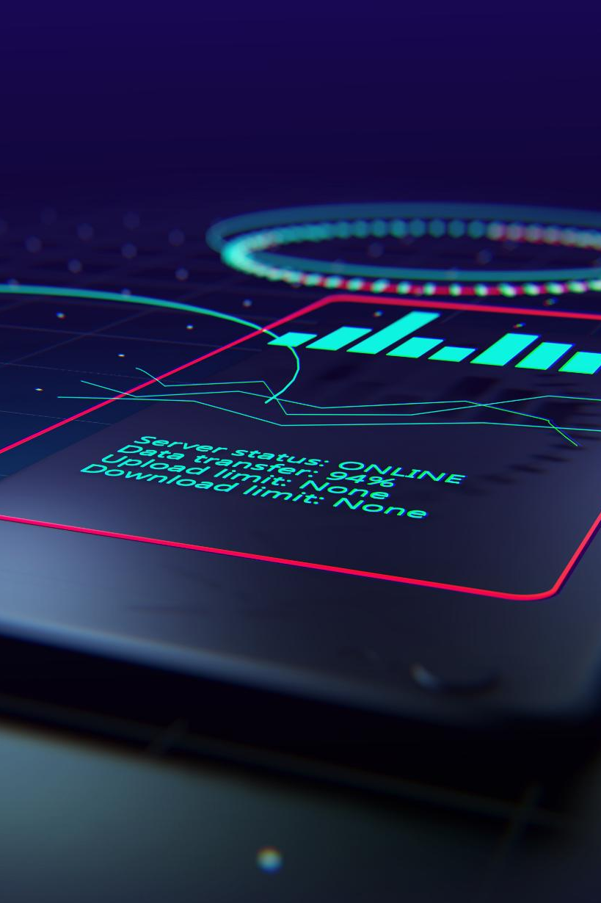
Creating Responsive UI for Real-Time Data
Importance of Responsiveness
Responsive UIs are crucial for BCI applications, enabling timely data updates and user interactions.
Strategies for UI Design
Implementing efficient design strategies in .NET MAUI can enhance user experience and interaction with real-time data.
Real-Time Data Visualization
Effective visualization of real-time data is essential for user comprehension and decision-making in BCI applications.
Notes:
The app is structured using the MVVM pattern. The MockBCIService generates data. The MainViewModel handles logic and state. The UI, built in XAML, binds to the ViewModel. This clean separation makes the app scalable and maintainable."

Slide 20
Simple Visualization Examples
Importance of Visualization
Visualizing brain activity data enhances user understanding and interaction with the information presented.
Simple Techniques Overview
This slide will showcase various simple techniques for effectively visualizing brain activity data.
User Interaction Enhancement
Effective visualizations improve user interaction by making complex data more accessible and understandable.
Notes:
"Delta, Theta, Alpha, and Beta waves are shown using progress bars. These waveforms are typically associated with different brain states—like sleep, relaxation, or focus—and are key to user feedback.“
"A concentration level is calculated using a ratio of Beta to Alpha waves. It’s a simplified model, but it gives users a clear visual cue, and simulates how mental state feedback could look in a real app.“
"Buttons like 'Meditation', 'Focus', and 'Distraction' simulate specific brain states by altering wave values. This helps test how the app behaves under different cognitive conditions."

Slide 21
Best Practices
Notes:
To ensure the success of your BCI applications, adhering to best practices is vital. This section will outline important considerations regarding performance, platform compatibility, error handling, and user experience.

Slide 22

Performance Considerations
Importance of Performance
In BCI applications, performance is essential for enabling seamless real-time interaction between the user and the system.
Strategies for Optimization
We will explore various strategies to optimize performance, focusing on efficient data handling and processing techniques.
Notes:
Performance is critical in BCI applications to achieve real-time interaction. We will discuss various strategies to optimize performance, including efficient data handling and processing.

Slide 23
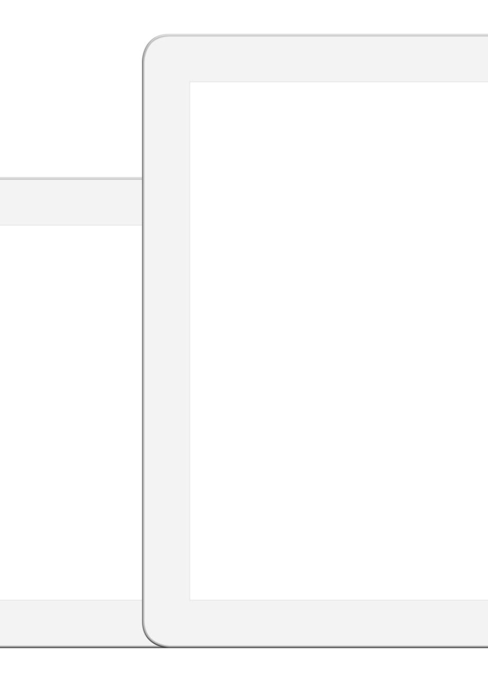
Cross-Platform Considerations
Unique Challenges
Developing cross-platform applications introduces unique challenges, including performance discrepancies and user experience variations across devices.
Key Considerations
Key considerations include consistent user experience, efficient resource management, and adaptable design for different platforms.
Seamless Functionality
Ensuring seamless functionality involves thorough testing and optimization for different environments and screen sizes.
Notes:
When developing cross-platform applications, there are unique challenges to address.
"Using .NET MAUI, this app runs on Android, iOS, Windows, macOS, and even Tizen. It uses platform-specific configurations and manifests to ensure native behavior across all devices."

Slide 24

Error Handling
Importance of Error Handling
Effective error handling is essential for ensuring a smooth and seamless user experience in BCI applications.
Error Detection Strategies
Implementing robust error detection techniques can help identify issues before they impact users.
Effective Management Approaches
Adopting effective error management approaches can significantly enhance the reliability of BCI applications.
Notes:
Robust error handling is crucial for maintaining a smooth user experience in BCI applications.

Slide 25

User Experience Guidelines
Importance of User Experience
User experience significantly impacts the effectiveness of BCI applications, influencing user satisfaction and adoption rates.
Designing Intuitive Interfaces
Intuitive interface design simplifies user interactions, making BCI applications more accessible and easier to use.
Engaging User Interactions
Engaging interactions enhance user participation, ensuring users remain focused and motivated while using BCI applications.
Notes:
User experience plays a vital role in the success of BCI applications.

Slide 26
Demo Application
Notes:
To illustrate the concepts discussed, we will present a demo application showcasing a simple brain wave monitor. This application will serve as a practical demonstration of the techniques learned.

Slide 27

Simple Brain Wave Monitor
Real-Time Monitoring
The application captures brain wave activity in real-time, providing immediate feedback on brain function.
Data Capture
It effectively captures data from Brain-Computer Interface (BCI) devices to analyze brain activity.
User Interface Features
The user interface presents brain wave data in an easily understandable format for users.
Notes:
Our demo application will monitor brain wave activity in real time. We will walk through its features, focusing on how it captures and displays data from BCI devices.

Slide 28
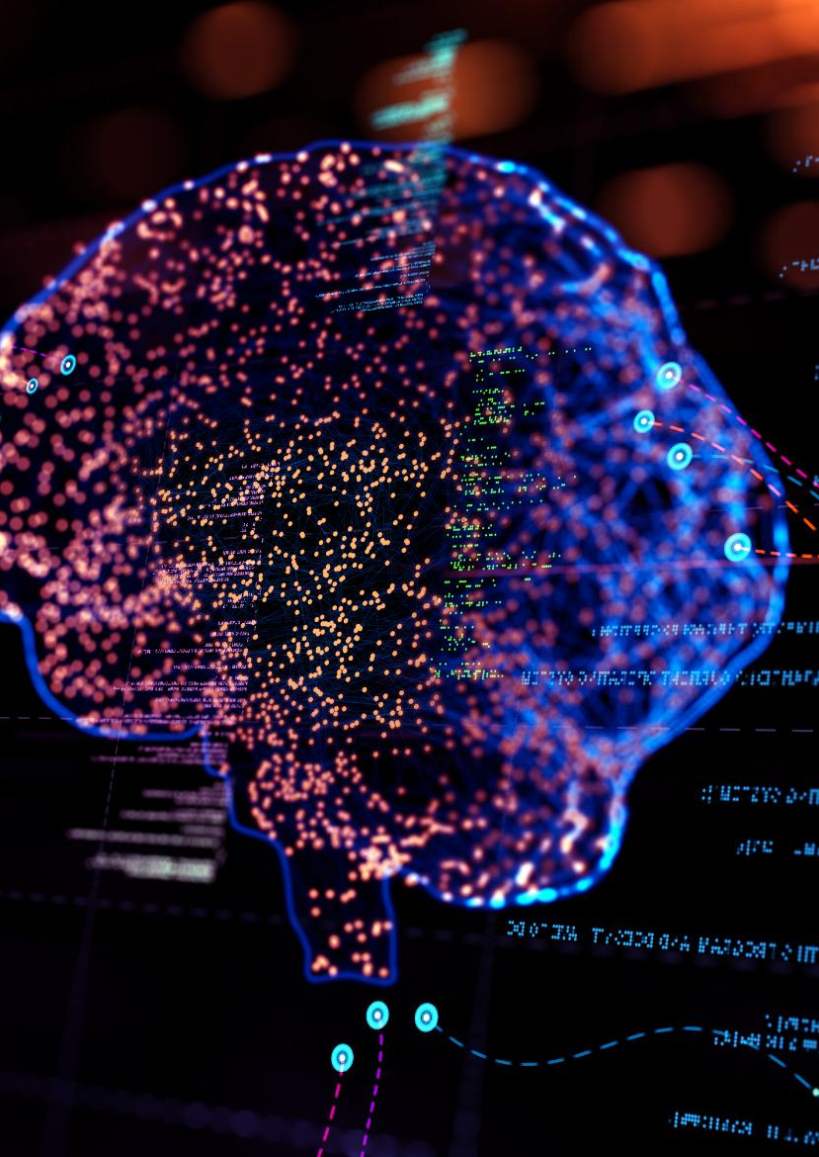
Basic Concentration Level Display
User Concentration Level
The application will monitor the user's brain activity to determine and display their concentration level in real-time.
Brain Activity Measurement
We will explain the technology behind measuring brain activity and how it correlates with concentration levels.
Implementation Overview
The functionality will include algorithms to process brain activity data and present the results effectively to the user.
Notes:
The demo application will also include a feature to display the user's concentration level based on brain activity. We will explain how this functionality is implemented.

Slide 29

Cross-Platform Deployment Examples
Cross-Platform Compatibility
Demonstrating how .NET MAUI allows applications to run seamlessly on multiple platforms, enhancing user accessibility.
Versatile BCI Applications
Showcasing BCI applications deployed across different environments, utilizing .NET MAUI's capabilities to enhance functionality.
Deployment Process
Highlighting the steps and tools involved in deploying a demo application using .NET MAUI across different platforms.
Notes:
Finally, we will showcase examples of how to deploy the demo application across different platforms, demonstrating the power of .NET MAUI in creating versatile BCI applications.

Slide 30
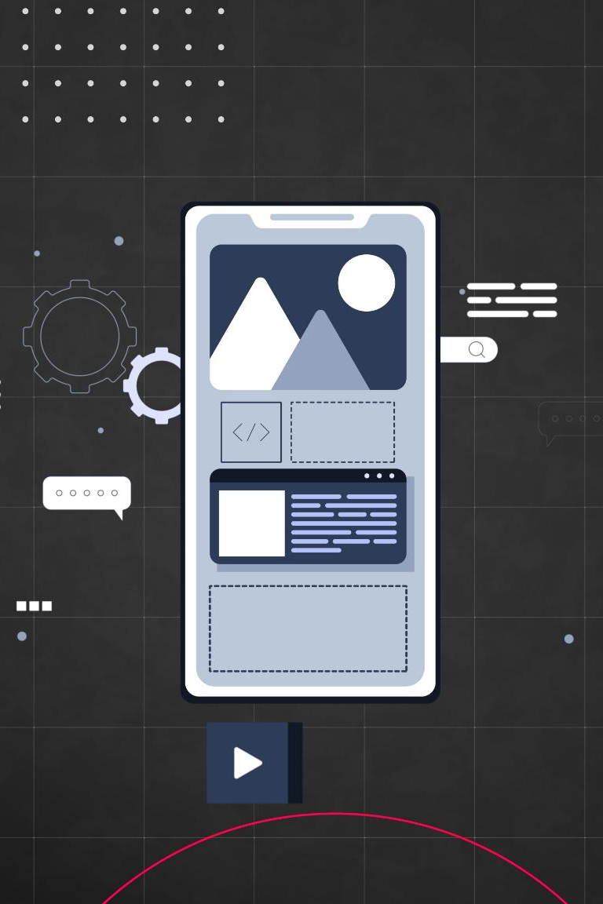
UI Binding Examples
Importance of UI Binding
UI binding is crucial for creating responsive applications that reflect real-time data changes to users seamlessly.
Demo will illustrate Practical Examples
UI binding techniques in .NET MAUI applications.
Real-time Applications
Learn how UI binding enhances user experience in real-time applications, making interactions more engaging and informative.
Notes:
Binding user interface elements to data streams is essential for real-time applications.

Slide 31
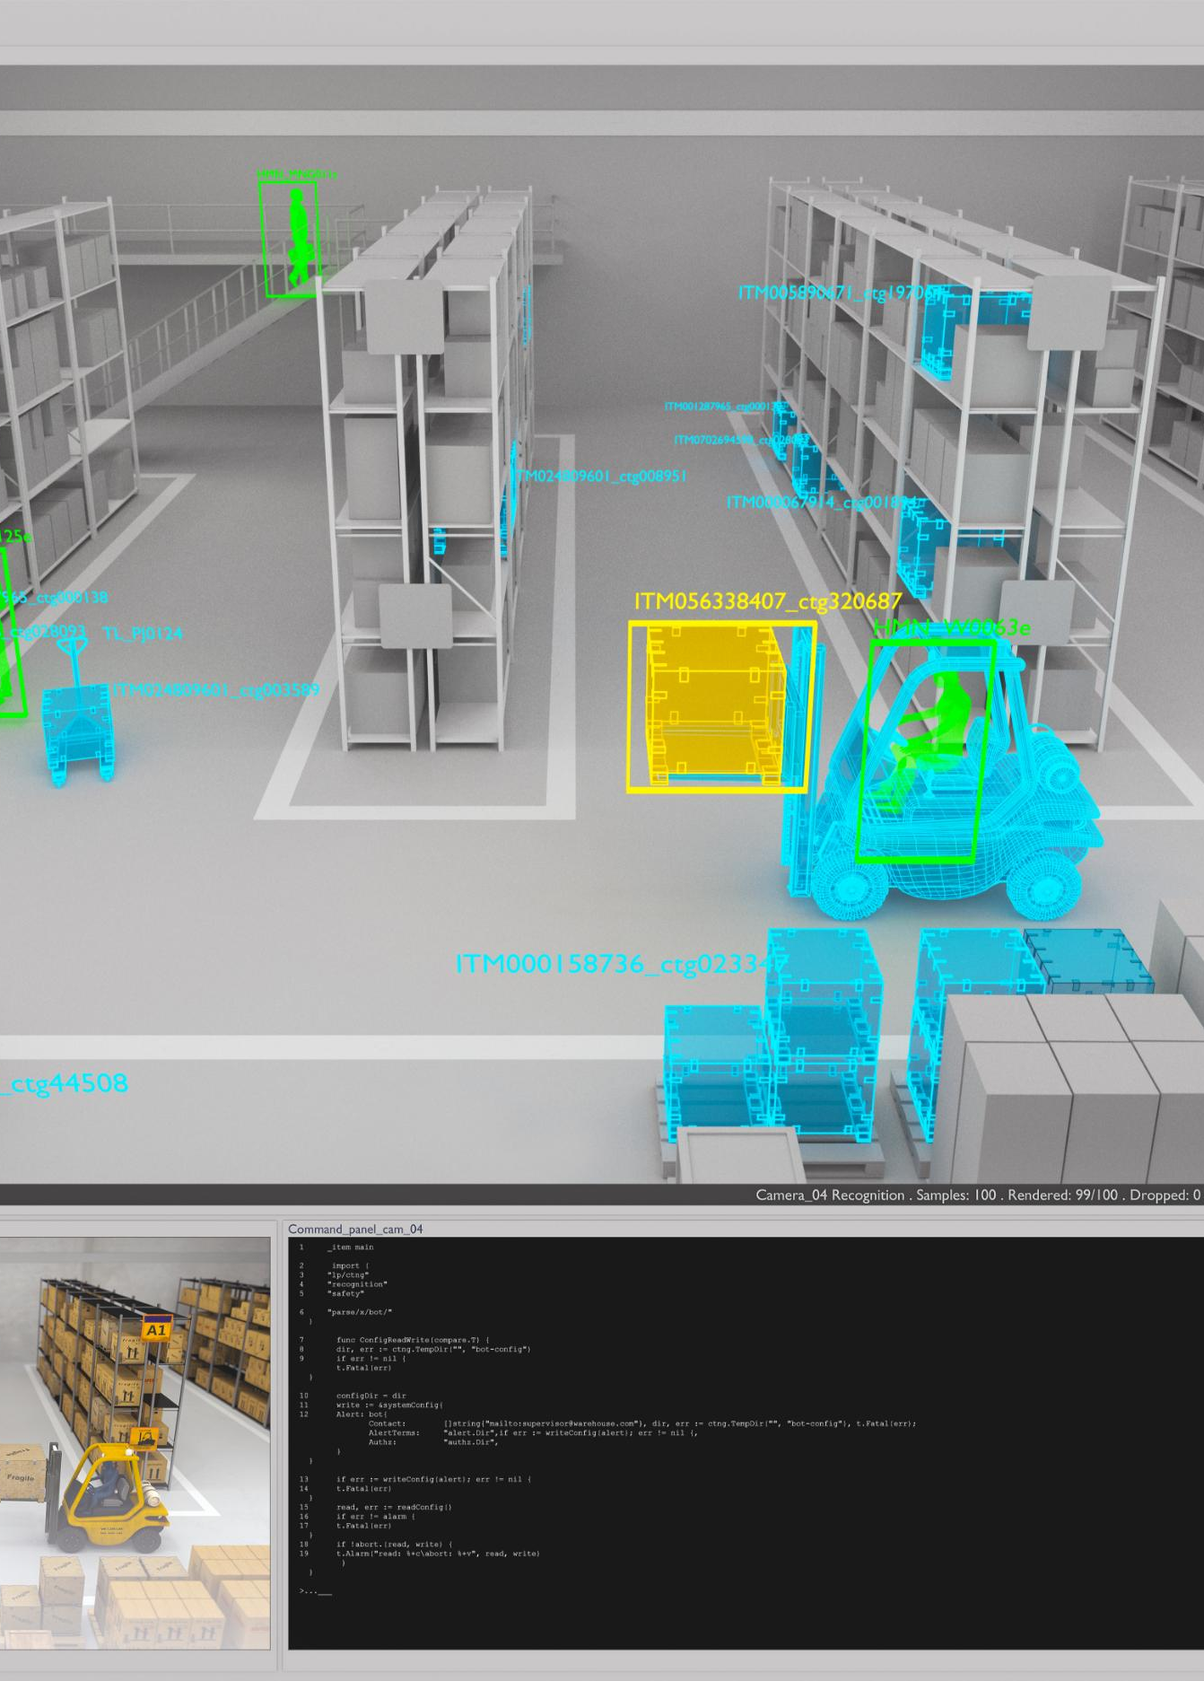
MVVM Pattern Implementation
MVVM Overview
The MVVM pattern separates application logic and UI, enhancing maintainability and testability in .NET MAUI applications.
Implementation in BCI Applications
Implementing MVVM in Brain-Computer Interface (BCI) applications streamlines user interaction and data binding processes.
This Demo is an Examples of MVVM https://github.com/Sayeh-1337/BCIMockAPP
Notes:
The Model-View-ViewModel (MVVM) pattern is a crucial design approach for .NET MAUI applications. "The app is structured using the MVVM pattern. The MockBCIService generates data. The MainViewModel handles logic and state. The UI, built in XAML, binds to the ViewModel. This clean separation makes the app scalable and maintainable."

Slide 32

EMOTIV Device Code Examples
Notes:
In this section, we will provide practical code examples that illustrate critical aspects of BCI application development, from device connections to UI bindings.

Slide 33
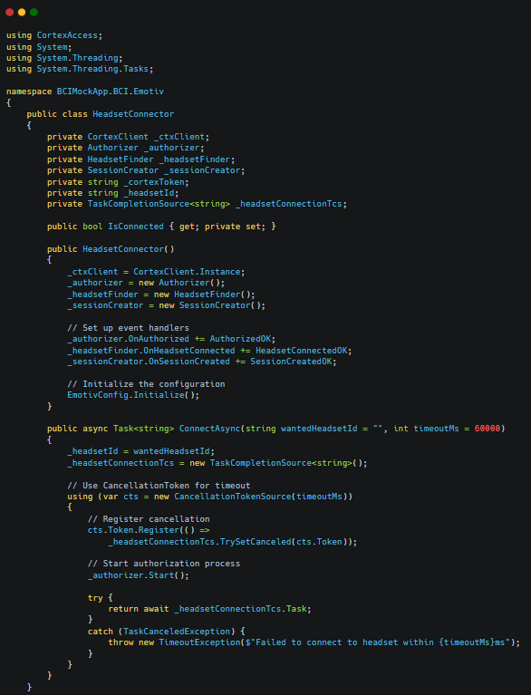
Basic Code Snippets for Device Connection using Emotiv Cortex API
Code Snippet Overview
This code illustrates a C# implementation for connecting to EMOTIV BCI devices. It handles the complete connection lifecycle including authorization, device discovery, and session management within an asynchronous framework.
Notes:
Here, we will share code snippets to help you connect to BCI devices effectively. These examples will provide a solid foundation for your implementation.

Slide 34
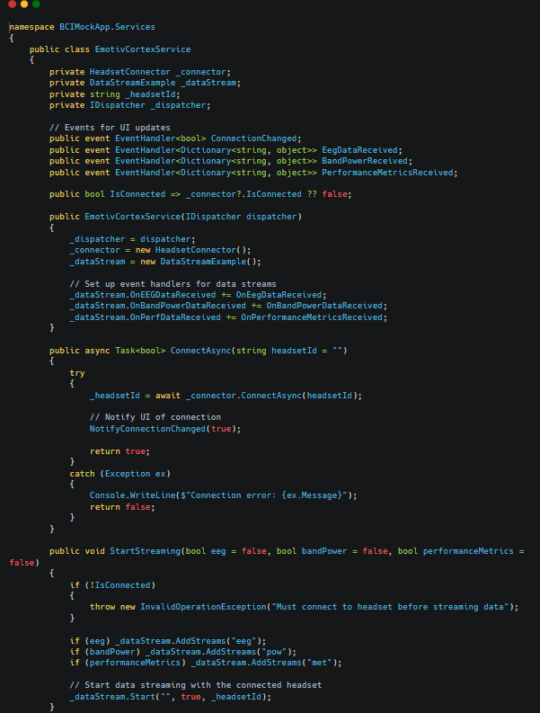
Data Processing Examples
EMOTIV Cortex Service
• Unified Interface for EMOTIV BCI Integration
Simplifies headset connection and data streaming
Manages multiple data streams (EEG, band power, metrics)
• Cross-Thread Communication
Thread-safe UI updates via MAUI Dispatcher
Event-based notification system
• Clean API Design
Simple connection method with error handling
Configurable data stream selection
Status monitoring through properties and events
• Production-Ready Implementation
Encapsulates SDK complexity
Notes:
Processing brain signal data is a key component of BCI applications. We will present code examples that demonstrate common data processing techniques.

Slide 35
Resources and Next Steps
Notes:
To conclude, we will provide resources for further learning, including libraries, tools, and community links. This section will also explore future development possibilities for BCI applications with .NET MAUI.

Slide 36

Learning Resources
Documentation Resources
Explore official documentation for BCI (EEG headsets) ( Manufacturer ) to gain a solid understanding of features and functionalities.
Tutorials and Guides
Find tutorials and guides that provide step-by-step instructions for working with .NET MAUI.
https://learn.microsoft.com/en-us/training/modules/build-mobile-and-desktop-apps/1-introduction
Online Tutorials and Materials
Notes:
To further your understanding of BCI and .NET MAUI, we will provide links to learning resources, including documentation, tutorials, and online courses.

Slide 37

Community Links
Community Engagement
Engaging with the community can foster collaboration and provide essential support for projects and ideas.
Online Forums
Online forums are valuable resources for sharing knowledge, asking questions, and finding solutions related to BCI and .NET MAUI.
Social Media Groups
Social media groups connect individuals with similar interests and facilitate discussions about BCI and .NET MAUI.
Notes:
Engaging with the community can provide invaluable support and insights. We will share links to forums, social media groups, and other communities focused on BCI and .NET MAUI.

Slide 38
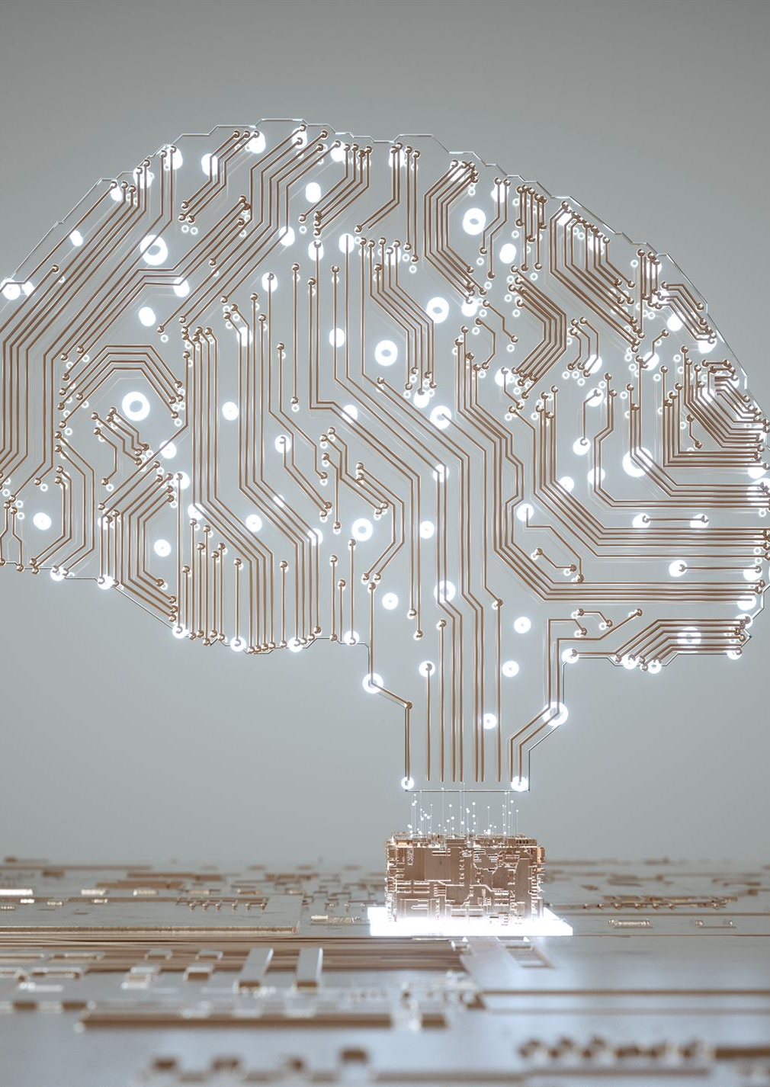
Future Development Possibilities
Emerging BCI Trends
The field of Brain-Computer Interfaces is rapidly evolving, with emerging trends shaping its future applications.
Development Opportunities
Future development opportunities in BCI hold great promise for enhancing human-computer interaction and accessibility.
Impact on Society
The advancements in BCI technology could significantly impact various aspects of society, including healthcare and communication.
Notes:
As technology evolves, so do the possibilities for BCI applications. We will discuss emerging trends and future development opportunities within the field of Brain-Computer Interfaces.

Slide 39
Conclusion
Opportunities in BCI Development
Building Brain-Computer Interface applications opens up new avenues for innovation and technology integration in various fields.
Utilizing .NET MAUI
.NET MAUI provides a robust framework for developing cross-platform applications, enhancing accessibility and usability in BCI solutions.
Impactful Applications
With the right tools and practices, developers can create applications that harness brain power for health, education, and more.
Notes:
In conclusion, building Brain-Computer Interface applications with .NET MAUI presents exciting opportunities. With the right knowledge, tools, and practices, you can create impactful applications that harness the power of the human brain.

